Slide 1
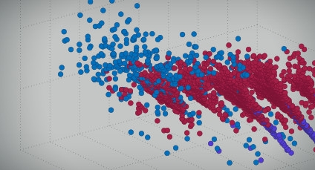
Machine Learning
Shiran Golan
Application Engineer
Shirang@systematics.co.il

Slide 2
Agenda
Machine Learning overview
Learning types and models
Machine Learning workflow
Example: Heart sound classification
Summary
Self-practice

Slide 3
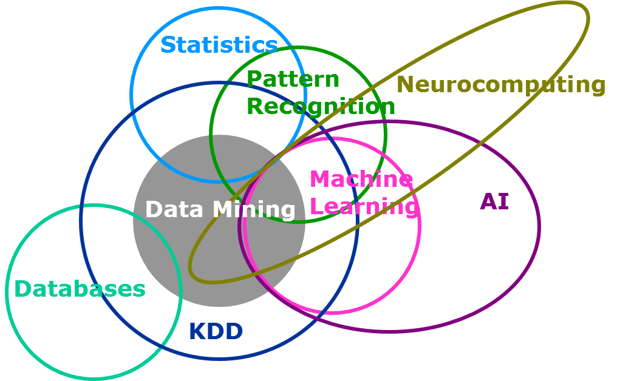
Machine Learning
Machine learning is a type of artificial intelligence (AI) that provides computers with the ability to learn without being explicitly programmed.
Notes:
https://www.analyticsvidhya.com/blog/2015/07/difference-machine-learning-statistical-modeling/
http://whatis.techtarget.com/definition/machine-learning

Slide 4

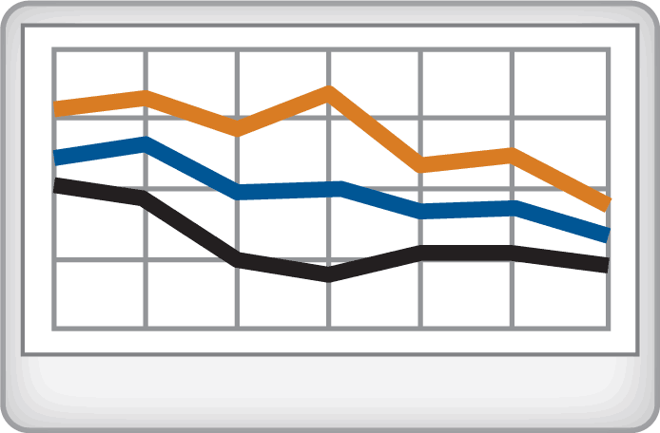
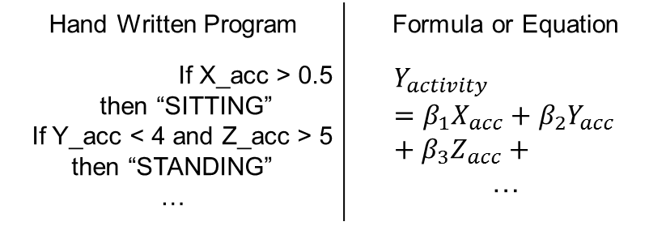
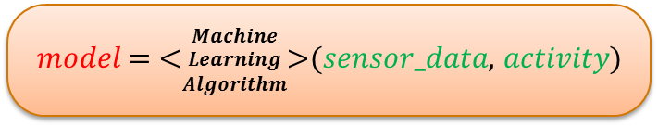

Machine Learning
Machine learning uses data and produces a program to perform a task
Task: Human Activity Detection
Standard Approach
Machine Learning Approach
Computer
Program
Machine
Learning
Hand Written Program | Formula or Equation
If X_acc > 0.5 then “SITTING” If Y_acc < 4 and Z_acc > 5 then “STANDING” … | $$Y_{activity}=β_{1}X_{acc}+β_{2}Y_{acc}+β_{3}Z_{acc}+$$ …
$$\text{model}:Inputs→Outputs$$
𝑚𝑜𝑑𝑒𝑙 = <$\begin{matrix}Machine \\ Learning \\ Algorithm\end{matrix}$>(𝑠𝑒𝑛𝑠𝑜𝑟_𝑑𝑎𝑡𝑎, 𝑎𝑐𝑡𝑖𝑣𝑖𝑡𝑦)
Notes:
So, what is machine learning?
Let’s take a minute to quickly go over the high-level concepts of machine learning.
Even if you are familiar with this topic, this should serve as a quick reminder of when it is actually useful to pursue machine learning.
We can define Machine learning as a technique that uses data and produces a program to perform a task
Let me explain that in the context of an example.
Consider a task which involves using sensor data from a mobile phone, to detect a person’s activity, for example if the person is walking, sitting, standing and so on.
The standard approach to solving such task,
Analyze the signal and write down a program with a set of well-designed rules
Or you may know a priori a set of equations or a formula that uses sensor inputs and predicts the output.
The machine learning approach is to learn such a computer program directly from data.
In this case we provide the algorithm with input and output data and have it learn the program to solve this task. This step is often referred to training. The output is a model that can now be used to detect activity from new sensor data.
I don’t explicitly mention a specific machine learning algorithm, because there are plenty of algorithms to choose from, and each have their own strengths and weaknesses. We’ll see that when we go through this particular example in detail.
If there are 2 things I’ll like for you to take away from this slide that would be
You need, data. If you don’t have data, you can’t do machine learning. Period. This is a strong requirement.
Consider machine learning when the task is complex that there is no magic equation or formula to solve it. If you have a formula, there is no learning required, you go ahead and implement it in MATLAB. Machine learning will work but is not the recommended approach.
In simple terms, machine learning uses data and produces a program to perform a task. This ability is especially useful for complex problems where closed form solutions might be too difficult or even impossible to derive.
Lets take the example of human activity detection using a smartphone. Our goal is to use the internal tri-axial accelerometer data to determine when a person is performing activities like sitting, standing and walking. If we take a traditional approach, we might be able to come up with some hand written rules based on empirical observations or we might try to develop a formula. In either case, the solution will be suboptimal as the problem is quite complex and the solution space has many combinatorial possibilities.
On the other hand, a machine learning solution would involve collection of large amounts of sensor data with corresponding activity labels and allowing the algorithm to learn the relationships between input and outputs. Depending on the complexity of the problem, we can choose to use a simple algorithm like naïve Bayes or go with something complex like support vector machines. Our task here is to select the most appropriate technique and avoid pitfalls such as overfitting.

Slide 5
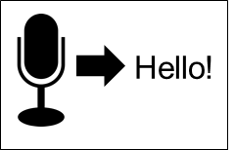
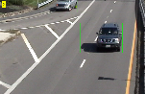
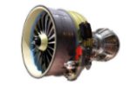
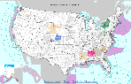
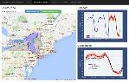
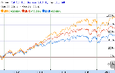
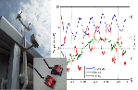
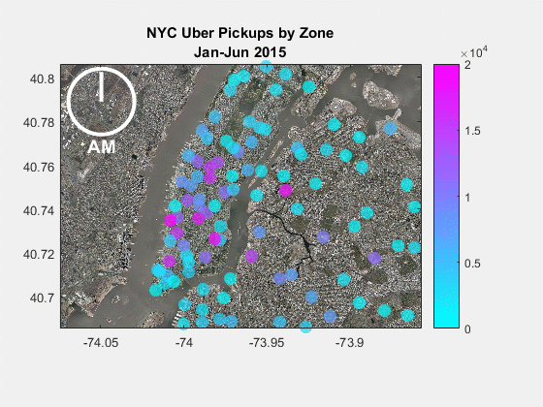
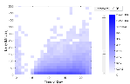
Consider Machine Learning When…
Problem is too complex for hand written rules or equations
Because algorithms can
learn complex non-linear relationships
Speech Recognition
Object Recognition
Engine Health Monitoring
Program needs to adapt with changing data
update as more data becomes available
Weather Forecasting
Energy Load Forecasting
Stock Market Prediction
Program needs to scale
learn efficiently from very large data sets
IoT Analytics
Taxi Availability
Airline Flight Delays
Notes:
Machine learning has become quite pervasive today. Here are some examples of applications where machine learning has enabled performance that would have been very difficult to achieve with traditional modeling techniques.
Lets take a look at the characteristics of these problems that make them such a good fit for machine learning techniques.
Problems such as speech recognition, object recognition and engine health monitoring are too complex for hand written rules or equations. Machine learning algorithms are designed to learn such complex non-linear relationships.
Weather forecasting, energy load forecasting and stock market prediction are examples of applications where the underlying system is constantly changing so the solution also needs to change and adapt. Machine learning algorithms can quickly learn from new data and thus keep up with such dynamic systems.
Applications like IoT analytics, taxi availability analysis and airline flight delay prediction typically involve learning from large amounts of data. Machine learning algorithms are designed to learn efficiently from such large datasets.

Slide 6

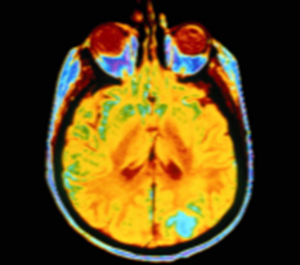

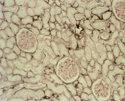
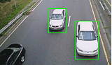
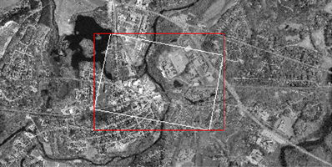
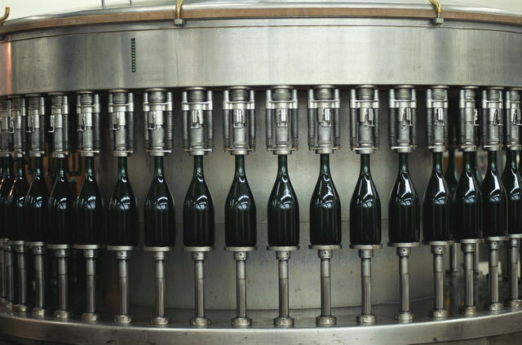

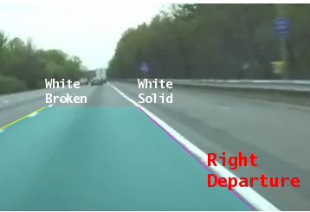
Machine Learning is Everywhere
Stock Prediction
Speech Recognition
Image Recognition
Medical Diagnosis
Data Analytics
Energy
Robotics
…
[TBD]
Notes:
Machine Learning is ubiquitous. These techniques are increasingly being used in today’s world to make critical business and life decisions.
Today, with Machine Learning, we are able solve problems in automotive, finance, computer vision and several other fields, that were previously considered impossible.

Slide 7

Challenges
Significant technical expertise required
No “one size fits all” solution
Time required to conduct the analysis
Need to deploy & integrate
Notes:
There are some inherent challenges associated with machine learning, as it is a complex field of study.
You may not have the technical knowhow.
There are so many algorithms, which one is suitable for my needs?
Typically, machine learning may entail black box modeling which may or may not be suitable for your application.
Most important of all, it may take numerous iterations before you find a suitable model or you may be working with large data sets which take longer to process, All these things have an impact on how long it takes for you to get to the results.
Today, I want to highlight how MATLAB can be used to address all of these challenges.

Slide 8
Agenda
Machine Learning overview
Learning types and models
Machine Learning workflow
Example: Heart sound classification
Summary
Self-practice

Slide 9
Unsupervised Vs. Supervised
Type of Learning
Categories of Algorithms
Unsupervised Learning
Clustering
Discover patterns or relationships
Group and interpret data based only on input data
Machine Learning
Regression
Supervised Learning
Model patterns or relationships
Classification
Develop predictive model based on both input and output data

Slide 10
Unsupervised Learning
Type of Learning
Categories of Algorithms
Unsupervised Learning
Clustering
Discover patterns or relationships
Group and interpret data based only on input data
Machine Learning
Regression
Supervised Learning
Classification

Slide 11
Unsupervised Learning - Clustering
What is clustering?
Segment data into groups, based on data similarity
Why use clustering?
Identify outliers
Resulting groups may be the matter of interest
How is clustering done?
It is an iterative process (involving trial and error)
Can be achieved by various algorithms

Slide 12
Unsupervised Learning - Clustering
k-Means,
Fuzzy C-Means
Hierarchical
Clustering
Neural Networks
Gaussian Mixture
Hidden Markov Model

Slide 13
Dimensionality Reduction
Observations can be thought of as points in n-dimensional space.
Feature transformation techniques reduce the dimensionality in the data by transforming data into new features.
Feature selection techniques are preferable when transformation of variables is not possible, e.g., when there are categorical variables in the data.

Slide 14
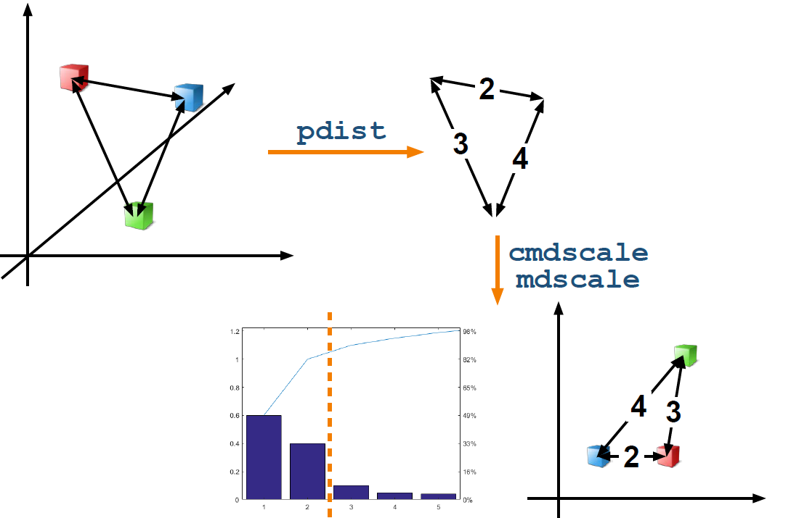
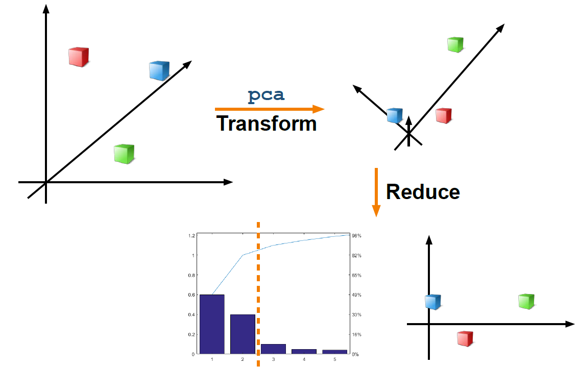
Dimensionality Reduction
Two ways to reduce the dimensionality of a data set are:
• Principal Component Analysis (PCA)
• Multidimensional scaling (MDS)

Slide 15
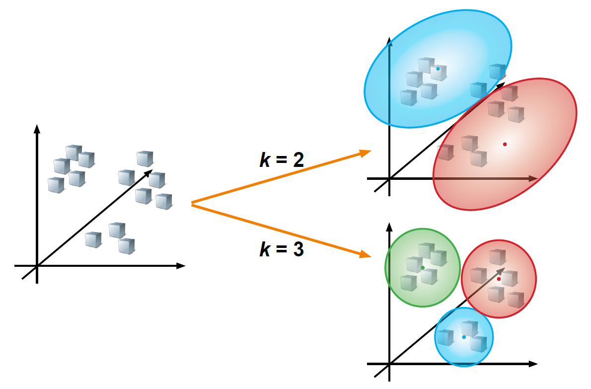
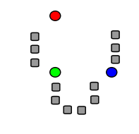
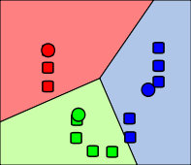
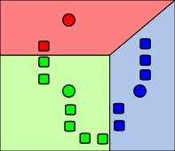
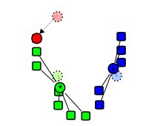
k-Means Clustering
Iterate
>> kidx = kmeans(Xtrain, nClusters,'distance',
'cityblock', ‘Replicates', 5, Name, Value)
https://en.wikipedia.org/wiki/K-means_clustering
Notes:
Kmeans היא שיטה שמגיעה מעולם עיבוד האותות.
Kmeans מאפשר לנו לחלק את המידע למספר קבוצות ידוע, כך שכל נקודה משויכת לקבוצה עם הממוצע הקרוב ביותר אליה.
התוצאה שנקבל מהאלגוריתם היא וקטור שאורכו כאורך מספר הדוגמאות שיש לנו, ולכל דוגמא נקבל לאיזה קבוצה היא שייכת -1,2, או 3 למשל.
[קליק] יש לנו מידע במרחב. האלגוריתם בוחר נקודות אקראיות ומגדיר אותן כמרכזי הקבוצות – צנטרואידים.
[קליק] האלגוריתם עובר על כל אחת מהנקודות ומחליט לאיזו קבוצה לשייך אותה לפי המרחק שלה מהצנטרואידים, ומתקבלת חלוקה לקבוצות
[קליק] מחשבים צנטרואיד לכל אחת מהקבוצות שהתקבלו.
[קליק] כעת האלגוריתם שוב מחפש את המרחק של כל אחת מהנקודות מהצנטרואידים החדשים שהתקבלו ומשייך כל נקודה לסנטרואיד אליו היא הכי קרובה, ומתקבלת חלוקה חדשה לקבוצות
[קליק] כך התהליך נמשך באופן איטרטיבי עד להתכנסות (כלומר שההבדל בין איטרציה לאיטרציה קטן מאוד או שאין הבדל)
centroids - the center of gravity or mean
k-means clustering is a method of vector quantization, originally from signal processing.
k-means clustering aims to partition n observations into k clusters in which each observation belongs to the cluster with the nearest mean, serving as a prototype of the cluster.
k-Means Clustering is a partitioning method which partitions data into k mutually exclusive clusters, and returns the index of the cluster to which it has assigned each observation.
1.k initial "means" (in this case k=3) are randomly generated within the data domain (shown in color).
2. k clusters are created by associating every observation with the nearest mean. The partitions here represent theVoronoi diagram generated by the means.
3. The centroid of each of the k clusters becomes the new mean.
4. Steps 2 and 3 are repeated until convergence has been reached.
As it is a heuristic algorithm, there is no guarantee that it will converge to the global optimum, and the result may depend on the initial clusters. As the algorithm is usually very fast, it is common to run it multiple times with different starting conditions.

Slide 16
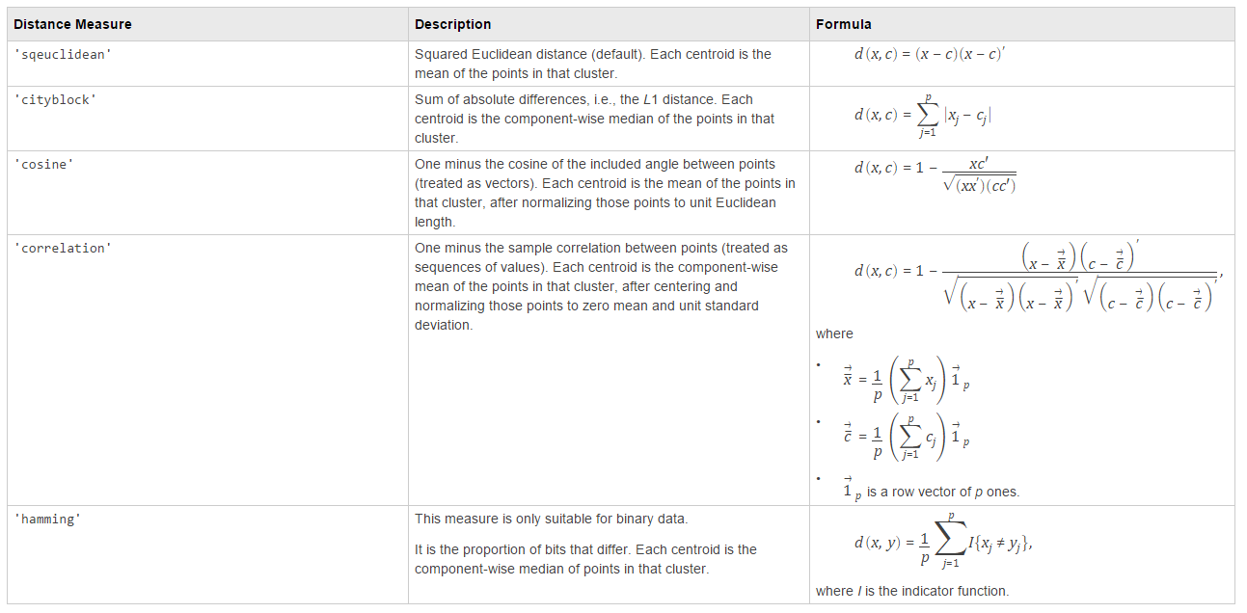
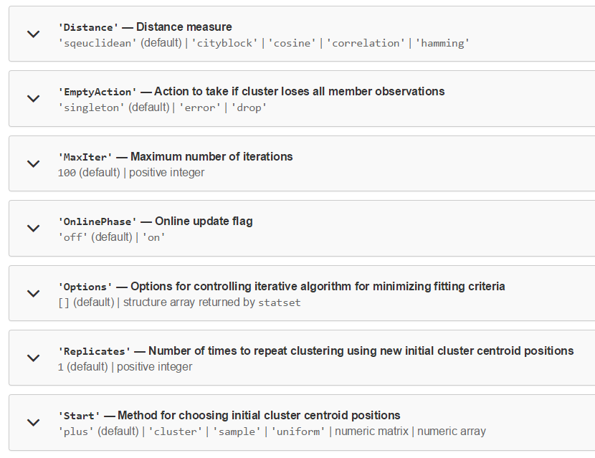
k-Means Clustering
Notes:
יש לנו אפשרות להגדיר פרמטרים שונים כאשר אנו מבצעים kmeans:
Start- מגדיר מה השיטה לבחירת תנאי ההתחלה כלומר בחירת הסנטרואידים הראשוניים. התוצאה שנקבל תלויה בתנאי ההתחלה הזה.
plus – עפ"י אלגוריתם שנקרא Kmeans++ שאפשר לקרוא עליו בדוקיומנטציה
uniform - באופן אקראי מסט הנקודות שיש לנו
numeric - על-פי הגדרת המשתמש
cluster - בהתבסס על בדיקה ראשונית על 10% מהמידע (ביצוע kmeans ולקיחת הסנטרואידים של התוצאה)
Distance - איזו יחידת מרחק למדוד בין הנקודות?
maxIter - מה מספר האיטרציות המקסימלי?
Replicates – ביצועי האלגוריתם תלויים בתנאי ההתחלה, ולכן ייתכן שנרצה להריץ מספר פעמים עם ת.ה. שונים ולבחור את האלגוריתם הטוב ביותר.
האלגוריתם מהיר לחישוב, ולכן נוכל לחזור על החישוב מספר פעמים.
k-means clustering is a method of vector quantization, originally from signal processing.
k-means clustering aims to partition n observations into k clusters in which each observation belongs to the cluster with the nearest mean, serving as a prototype of the cluster.
k-Means Clustering is a partitioning method which partitions data into k mutually exclusive clusters, and returns the index of the cluster to which it has assigned each observation.
1.k initial "means" (in this case k=3) are randomly generated within the data domain (shown in color).
2. k clusters are created by associating every observation with the nearest mean. The partitions here represent theVoronoi diagram generated by the means.
3. The centroid of each of thek clusters becomes the new mean.
4. Steps 2 and 3 are repeated until convergence has been reached.
As it is a heuristic algorithm, there is no guarantee that it will converge to the global optimum, and the result may depend on the initial clusters. As the algorithm is usually very fast, it is common to run it multiple times with different starting conditions.

Slide 17
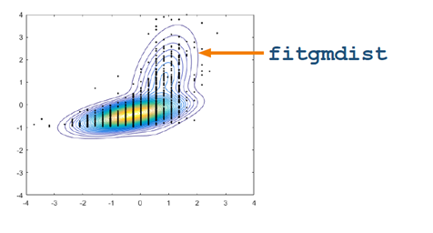
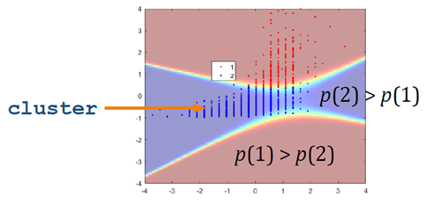
Gaussian Mixture Models
Modeling the distribution of clustered data as the combination of several multidimensional Gaussian distributions.
>> gmfit = fitgmdist(X,k,'CovarianceType','full',
'SharedCovariance',false,'Start',cluster0)
>> clusterX = cluster(gmfit,X);
Notes:
בGMM אנחנו רוצים למצוא דרך לייצג את המידע ע"י מספר רכיבים של התפלגות גאוסיאנית, כך שכל רכיב מוגדר ע"י ממוצע ומטריצת covariance.
התאמת המודל נעשית באופן איטרטיבי ע"י אלגוריתם Expectation-Maximization.
האלגוריתם מתחיל מתנאי התחלה של ממוצע ומטריצת cov לכל רכיב.
לאחר מכן מחושב לכל תצפית ערך ההסתברות שהיא שייכת לכל אחד מהרכיבים, כך שאנחנו מקבלים מטריצה שגודלה מספר התצפיות X מספר הרכיבים.
האלגוריתם משתמש בערכי ההסתבורויות כמשקלים ומעריך את הממוצע ומטריצת הcov ע"י שימוש באלגוריתם ML.
האלגוריתם ממשיך באופן איטרטיבי עד להתכנסות.
התוצאה המתקבלת תלויה בתנאי ההתחלה.
אנחנו מקבלים מודל GMM בו נוכל להשתמש כדי לסווג את המידע בהתבסס על הסתברויות על-ידי חישוב ההסתברות של כל תצפית להיגע מכל אחד מהרכיבים במודל.
התצפית מסווגת לרכיב עם ההסתברות הגבוהה ביותר.
נוכל לקבל את כל ההסתברויות וכך להסיק לגבי מידת הודאות בסיווג.
Gaussian mixture models (GMM) are composed of k multivariate normal density components, where k is a positive integer. Each component has a d-dimensional mean (d is a positive integer), d-by-d covariance matrix, and a mixing proportion. Mixing proportion j determines the proportion of the population composed by component j, j = 1,...,k.
You can fit a GMM using the function fitgmdist by specifying k and by supplying X, an n-by-d matrix of data.
The columns of X correspond to predictors, features, or attributes, and the rows correspond to observations or examples. By default, fitgmdist fits full covariance matrices that are different among components (or unshared).
fitgmdist fits GMMs to data using the iterative Expectation-Maximization (EM) algorithm. Using initial values for component means, covariance matrices, and mixing proportions, the EM algorithm proceeds using these steps:
1.For each observation, the algorithm computes posterior probabilities of component memberships. You can think of the result as an n-by-k matrix, where element (i,j) contains the posterior probability that observation i is from component j. This is the E-step of the EM algorithm.
2.Using the component-membership posterior probabilities as weights, the algorithm estimates the component means, covariance matrices, and mixing proportions by applying maximum likelihood. This is the M-step of the EM algorithm.
The algorithm iterates over these steps until convergence. The likelihood surface is complex, and the algorithm might converge to a local optimum. Also, the resulting local optimum might depend on the initial conditions. fitgmdist has several options for choosing initial conditions, including random component assignments for the observations and the k-means ++ algorithm.
fitgmdist returns a fitted gmdistribution model object. The object contains properties that store the estimation results, which include the estimated parameters, convergence information, and information criteria (Akaike and Bayesian information criteria). You can use dot notation to access the properties.
Once you have a fitted GMM, you can cluster query data using it. Clustering using GMM is sometimes considered a soft clustering method. The posterior probabilities for each point indicate that each data point has some probability of belonging to each cluster. For more information on clustering with GMM, see Clustering Using Gaussian Mixture Models.
Gaussian Mixture Models (GMM) involve modeling the distribution of
clustered data as the combination of several multidimensional normal
(Gaussian) distributions. This is achieved by a distribution fit:
>> gm = fitgmdist(X,k);
Once the distribution fit has been performed, the data can be classified
probabilistically, by calculating each observation’s posterior probability for each
component. The observation is assigned to a cluster according to whichever
component has the greatest probability.
>> g = cluster(gm,X);
Note that the assignment of an observation to a given cluster is probabilistic.
You can obtain the individual probabilities that are used to determine the
clusters:
>> [g,~,p] = cluster(gm,X);
The matrix p has k columns, one for each of the k components. This can help
evaluate the “certainty” of each observation’s cluster assignment.
In some cases, the data is not well suited to fitting multivariate normal
distributions. There are several options to adjust the model. For example, it is
possible to specify the type of covariance matrix (full or diagonal). It can be
helpful to change the covariance type to diagonal if the model fails due to an
ill-conditioned or singular covariance matrix.
>> gm = fitgmdist(X,k,...
'CovarianceType','diagonal');

Slide 18
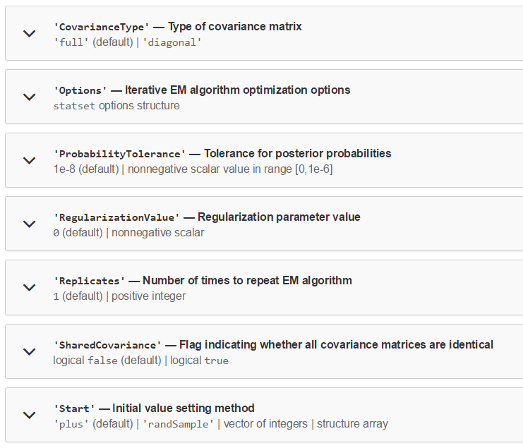
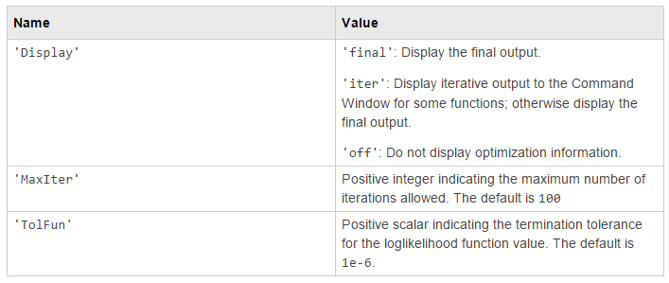
Gaussian Mixture Models
Notes:
נוכל להגדיר פרמטרים שונים לבניית המודל, כמו תנאי התחלה, מספר איטרציות מקסימלי ואפשרות להריץ את האלגוריתם EM מספר פעמים ובחירת המודל המתאים ביותר.

Slide 19
Supervised Learning
Type of Learning
Categories of Algorithms
Unsupervised Learning
Clustering
Machine Learning
Regression
Supervised Learning
Model patterns or relationships
Classification
Develop predictive model based on both input and output data

Slide 20
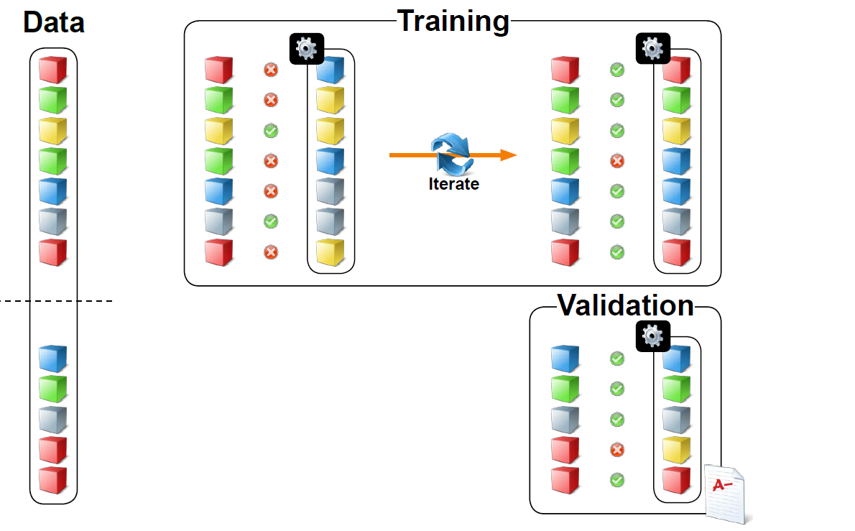
Training and Validation
>> pt = cvpartition(data.labels, 'Holdout', 0.3);
>> dataTrain = data(pt.training,:)
>> dataTest = data(pt.testing,:)
Notes:
When evaluating a classification or regression model, it is important to
anticipate how the model will generalize to new data. It would be beneficial to
have a set of data for training, used for model development, and a set of data
for validation of the model, with all classes known a priori.
One simple approach is to randomly partition the data into disjoint training
and validation sets. You can do this with the cvpartition function with
the 'Holdout' option:
>> pt = cvpartition(y,'Holdout',0.3);
This creates a random partition of the data, with 30% of the data reserved for
the validation (or holdout) set. The partition variable, pt, can be passed into
the training and test functions, which return logical vectors that can be
used as indices to separate the data:
data(pt.training,:)
data(pt.testing,:)
Statistics and Machine Learning Toolbox provides many functions for fitting
different kinds classification models. These functions take the form fitcX
where X represents the kind of classification method. They take a table of data
and the name of the response variable as input and return the trained model
as output:
>> mdl = fitcknn(dataTrain,'y');
If your data is split into a numeric matrix of predictors X and a vector of
responses y, you can also use these as inputs:
>> mdl = fitcknn(X,y);
Having trained the classification model, you can use the predict function
to predict the class of new observations:
>> yPred = predict(mdl,dataValid)

Slide 21
Supervised Learning
Regression
Neural Networks
Decision Trees
Ensemble Methods
Non-linear Reg.
(GLM, Logistic)
Linear Regression
Classification
Support Vector Machines
Discriminant Analysis
Naive Bayes
Nearest Neighbor

Slide 22
Supervised Learning - Classification
What is classification?
Predicting the best group for each point
“Learns” from labeled observations
Uses input features
Why use classification?
Accurately group data never seen before
How is classification done?
Can use several algorithms to build a predictive model
Good training data is critical

Slide 23
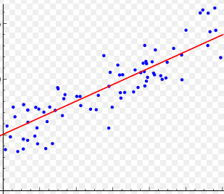
Supervised Learning - Regression
What is regression?
“classification, but for continuous variables”
Why use regression?
Predict a continuous response for a new observation
How is regression done?
linear, non-linear, paramtric or non-parametric

Slide 24
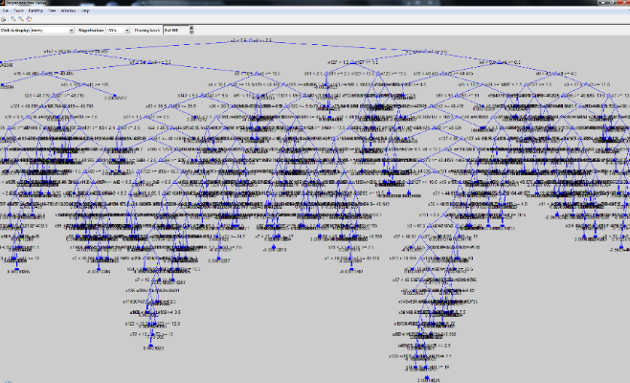
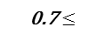
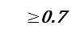
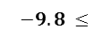
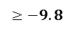
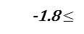
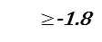
Decision Trees
>> view(tree,'Mode','graph')
X (X₁, X₂, X₃)
X3
Root/Start node
$$−9.8 ≤$$
$$≥−9.8$$
X1
X2
Split/Decision node(s)
-1.8$≤$
$≥$-1.8
0.7$≤$
$≥$0.7
Leaf/Edge node(s)
1
2
1
3
Branch or Classification rule
>> tree = fitctree(Xtrain, Y, 'MaxNumSplits', 20, Name, Value)
>> prunedTree = prune(tree, ‘Level’, 3)
© 2011 John Wiley & Sons, Inc. WIREs Data Mining Knowl Discov 2011 1 14–23DOI: 10.1002/widm.8
Notes:
עץ החלטה הוא מבנה שנראה כמו תרשים זרימה.
ישנם סוגים של עצי החלטה הם עצי ריגרסיה שבהם מותאם ערך רציף לכל תצפית ועצי סיווג שבהם מותאם ערך בדיד או מחלקת סוג לכל תצפית.
זהו למעשה עץ בינארי מלא המורכב מצמתי החלטה שבכל אחד מהם נבדק תנאי מסוים על מאפיין מסוים של התצפיות ועלים (קצוות) המכילים את הערך החזוי עבור התצפית המתאימה למסלול שמוביל אליהם בעץ.
נוכל לקצץ עצים ע"י Prune. במצב כזה נקבל ביצועים פחות טובים על ה-training set שלנו, וביצועים יותר טובים על ה-test set.
נוכל להציג את העץ ע"י הפונקציה View, כפי שניתן לראות במצגת.
עץ החלטה הוא ייצוג פשוט לסיווג דוגמאות. למידה מבוססת עץ החלטה היא אחת הטכניקות המוצלחות ביותר ללמידה מפוקחת באמצעות סיווג.
עץ יכול "ללמוד" על ידי פיצול קבוצת המקור לתתי קבוצות, המתבססות על מתן ערך לתכונה. תהליך זה חוזר על עצמו בכל תת-קבוצה באופן רקורסיבי, ונקרא מחיצות רקורסיביות. הרקורסיה מושלמת כאשר כל קבוצות המשנה בצומת בעלות אותו ערך מטרה, או כאשר הפיצול כבר אינו מוסיף ערך לתחזיות. תהליך זה של אינדוקציה מלמעלה למטה בעצי החלטה, הוא דוגמה לאלגוריתם נפוץ במיוחד לעצים אשר לומדים החלטה מהנתונים. בכריית נתונים, ניתן לתאר עצי החלטה גם כשילוב של טכניקות מתמטיות וחישוביות, המסייעות בתיאור, סיווג והכללה של קבוצה נתונה של נתונים.
A decision tree is a flow-chart-like structure, where each internal (non-leaf) node denotes a test on an attribute, each branch represents the outcome of a test, and each leaf (or terminal) node holds a class label. The topmost node in a tree is the root node.
Algorithms for constructing decision trees usually work top-down, by choosing a variable at each step that best splits the set of items.^{[11]} Different algorithms use different metrics for measuring "best".
1.Start at the root node.
2. For each X, find the set S that minimizes the sum of the node impurities in the two child nodes and choose the split {X∗ ∈ S∗} that gives the minimum overall X and S.
3. If a stopping criterion is reached, exit. Otherwise, apply step 2 to each child node in turn.

Slide 25
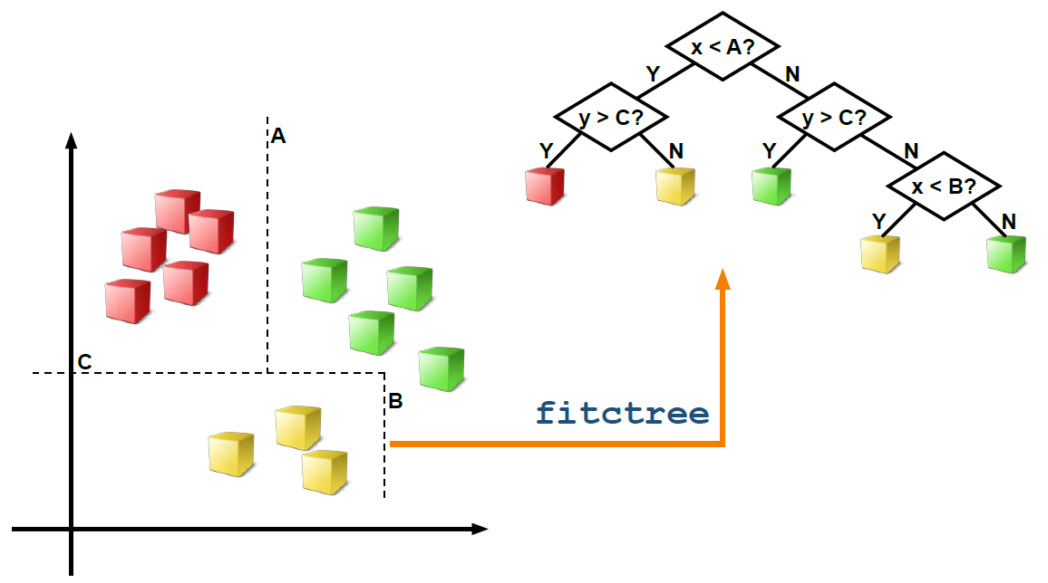
Characteristics of Decision Trees
Predictors - Can be both categorical and numeric.
Time - Fitting time increases with the size of the data.
Quick to predict.
Memory Overhead – Small.

Slide 26
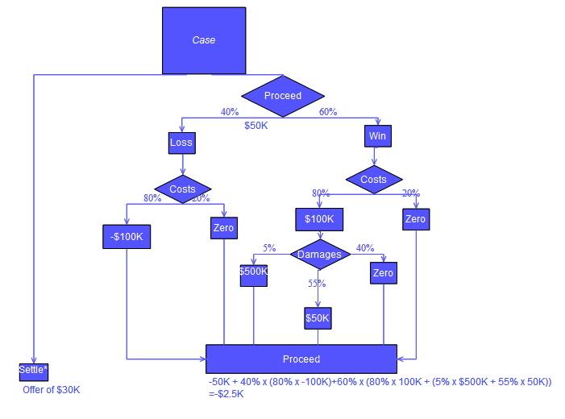
Characteristics of Decision Trees
Common Properties to Modify
SplitCriterion: Formula used to determine optimal splits at each level.
(Default: Gini’s diversity index.)
MinLeafSize: Minimum number of observations in each leaf node. (Default: 1.)
MaxNumSplits: Maximum number of splits allowed in the decision tree.
(Default: one fewer than the number of observations.)

Slide 27
K-Nearest Neighbor
Determine k points that are nearest to the unlabeled point.
Find the class of those points.
Assign the class that has the smallest expected misclassification cost.
?
>> knn = fitcknn (Xtrain, Y, 'NumNeighbors',10, 'Distance','Hamming', Name, Value)
>> activity = predict(knn ,X)
Notes:
שיטה ישירה ויעילה היא שיטת הnearest neighbor. הרעיון הוא לסווג נקודה חדשה בהתבסס על הסיווג של נקודות סמוכות אליה.
למעשה לא נדרש שלב אימון מפורש אלא רק בנייה של אובייקט המכיל את כל המידע וההגדרות הדרושים לסיווג.
את k אנחנו צריכים לבחור, והערך האופטימלי תלוי במידע שאנו עובדים איתו. ערך גדול מדי יוריד את אפקט הרעש בסיווג אבל הגבולות בין הקבוצות יהיו פחות ברורים.
ישנן שיטות לבחירת ערכו של k (Grid or Random search, Gradient Based Optimization…).
k-NN is a type of instance-based learning, or lazy learning, where the function is only approximated locally and all computation is deferred until classification.
An object is classified by a majority vote of its neighbors, with the object being assigned to the class most common among its k nearest neighbors (measured by a distance function, Euclidean/Manahattan/Minkowski).
No explicit training step is required. In the instance of categorical variables the Hamming distance must be used.
The best choice of k depends upon the data; generally, larger values of k reduce the effect of noise on the classification,^{[5]} but make boundaries between classes less distinct. A good k can be selected by various heuristic techniques (Grid or Random search, Gradient Based Optimization…)
Hamming distance - percentage of coordinates that differ.
One of the most straightforward, yet effective, ways to categorize data points is to classify a new point based on the pairwise distance to the nearest point.
The k-nearest neighbor (k-NN) algorithm uses the majority vote from k neighboring points to determine the class of the unlabeled data.
In general, the model determines k points that are nearest to the unlabeled point, finds the class of those points, and assigns the class that has the smallest expected misclassification cost.
To construct a k-nearest neighbor classifier, use the fitcknn function:
>> knnModel = fitcknn(dataTrain,'y');
By default, fitcknn uses a single neighbor for the classification (i.e., k = 1).
However, classifying based on the single closest neighbor can be very sensitive
to the initial data, and thus would not generalize well. To specify k in the
model, use the NumNeighbors property:
>> knnModel = fitcknn(dataTrain,'NumNeighbors',4);
If the knnModel variable is already in the workspace, you can modify the
properties with dot notation:
>> knnModel.NumNeighbors = 4;
There are a variety of distance metrics that can be used to determine the
nearest observation. The default pairwise distance measure is simple Euclidean
distance. The metric can be specified using the Distance property.

Slide 28
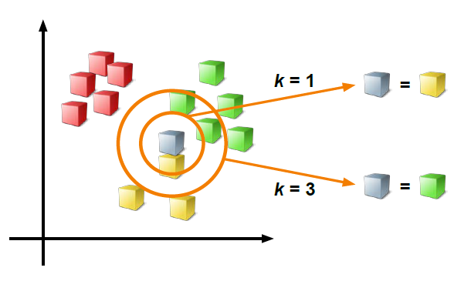
Characteristics of K-Nearest Neighbor
Predictors - Predictors can be all categorical or all numeric, but not a mix.
Time - Quick to fit.
Prediction time increases with the square of the size of the data.
Best for small data sets (hundreds or thousands of observations).
Memory Overhead – Small.
Notes:
Predictors - Predictors can be all categorical or all numeric, but not a mix.
Time - Quick to fit (does not depend on the size of the data).
Prediction time increases with the square of the size of the data.
Best for small data sets (hundreds or thousands of observations).
Memory Overhead – Small.

Slide 29

Characteristics of K-Nearest Neighbor
Common Properties to Modify
NumNeighbors: k, the number of neighbors used to classify new observations. (Default: k = 1.)
Distance: Metric used for calculating distances between observations.
(Default: Euclidean for numeric predictors; Hamming for categorical.)
DistanceWeight: Weighting given to the k nearest neighbors when
classifying new observations. (Default: equal.)
Notes:
Hamming distance - percentage of coordinates that differ.

Slide 30
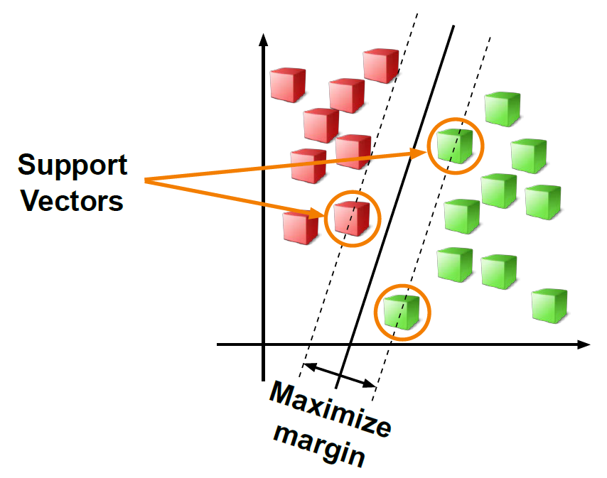
Support Vector Machine
The Support Vector Machine (SVN) algorithm classifies data by finding the “best” hyperplane that separates all data points of one class from those of the other class.
Best hyperplane - the one with the largest margin between the two classes.
The classification step becomes a function of the support vectors only - simple and robust to outliers.
Notes:
An SVM model is a representation of the examples as points in space, mapped so that the examples of the separate categories are divided by a clear gap that is as wide as possible.
New examples are then mapped into that same space and predicted to belong to a category based on which side of the gap they fall on.
In addition to performing linear classification, SVMs can efficiently perform a non-linear classification using what is called the kernel trick, implicitly mapping their inputs into high-dimensional feature spaces.
More formally, a support vector machine constructs a hyperplane or set of hyperplanes in a high- or infinite-dimensional space
Intuitively, a good separation is achieved by the hyperplane that has the largest distance to the nearest training-data point of any class
the mappings used by SVM schemes are designed to ensure that dot products may be computed easily in terms of the variables in the original space, by defining them in terms of a kernel function selected to suit the problem.
Kernel machines are used to compute a non-linearly separable functions into a higher dimension linearly separable function.
Like linear discriminant analysis, the Support Vector Machine (SVM) algorithm
classifies data by finding the “best” hyperplane that separates all data points
of one class from those of the other class. The best hyperplane for an SVM
means the one with the largest margin between the two classes. The margin
is calculated by finding the maximal width of the margin that contains no
interior data points.
The support vectors are the data points that are closest to the separating hyperplane,
on the boundary of the margin. The classification step becomes a function of
these support vectors only, which greatly simplifies the problem. It is also
intuitively reasonable to consider only the observations near the boundary for
the purposes of classification, as it makes the classification more robust to
outliers.
For problems that are not strictly linearly separable, a linear SVM maximizes
the soft margin – that is, it optimizes an objective that combines margin width
with a penalty for misclassified observations.
Use the fitcsvm function to create an SVM classifier:
>> svmModel = fitcsvm(dataTrain,'y');
Even with soft margins, many problems are not linearly separable. In this
case, you can still use an SVM by applying a nonlinear transformation to the
space of predictor variables. The linear boundary in this transformed space
corresponds to a nonlinear boundary in the original predictors. Use the
'KernelFunction' option to set the SVM transformation function:
>> svmModel = fitcsvm(dataTrain,'y',...
'KernelFunction','gaussian');
Note that SVMs work only on binary classification problems (only two
response classes). To perform a multiclass classification, use a comination of
binary SVMs.
Like linear discriminant analysis, the Support Vector Machine (SVM) algorithm
classifies data by finding the “best” hyperplane that separates all data points
of one class from those of the other class.
The best hyperplane for an SVM means the one with the largest margin between the two classes.
The margin is calculated by finding the maximal width of the margin that contains no
interior data points.
The support vectors are the data points that are closest to the separating hyperplane,
on the boundary of the margin. The classification step becomes a function of
these support vectors only, which greatly simplifies the problem. It is also
intuitively reasonable to consider only the observations near the boundary for
the purposes of classification, as it makes the classification more robust to
outliers.
For problems that are not strictly linearly separable, a linear SVM maximizes
the soft margin – that is, it optimizes an objective that combines margin width
with a penalty for misclassified observations.
Use the fitcsvm function to create an SVM classifier:
>> svmModel = fitcsvm(dataTrain,'y');
Even with soft margins, many problems are not linearly separable. In this
case, you can still use an SVM by applying a nonlinear transformation to the
space of predictor variables. The linear boundary in this transformed space
corresponds to a nonlinear boundary in the original predictors. Use the
'KernelFunction' option to set the SVM transformation function:
>> svmModel = fitcsvm(dataTrain,'y',...
'KernelFunction','gaussian');
Note that SVMs work only on binary classification problems (only two
response classes). To perform a multiclass classification, use a comination of
binary SVMs.

Slide 31

Support Vector Machine
m
m
$$∅\left(x\right)$$
Binary case
>> svm = fitcsvm(Xtrain, Y, 'ClassNames',actlabels,'KernelFunction', 'RBF', Name, Value)
Multiclass case
>> templateSVM = templateSVM('KernelFunction', ‘RBF', 'Standardize', true, Name, Value);
>> svm = fitcecoc(Xtrain, Y, 'Learners', templateSVM, 'Coding','onevsall')
>> [activity,score] = predict(svm ,X)
https://en.wikipedia.org/wiki/Support_vector_machine
Notes:
Many problems are not linearly separable. In this case, you can still use an SVM by applying a nonlinear transformation to the space of predictor variables. The linear boundary in this transformed space corresponds to a nonlinear boundary in the original predictors. Use the 'KernelFunction' option to set the SVM transformation function:
>> svmModel = fitcsvm(dataTrain,'y', 'KernelFunction','gaussian');
An SVM model is a representation of the examples as points in space, mapped so that the examples of the separate categories are divided by a clear gap that is as wide as possible. New examples are then mapped into that same space and predicted to belong to a category based on which side of the gap they fall on.
In addition to performing linear classification, SVMs can efficiently perform a non-linear classification using what is called the kernel trick, implicitly mapping their inputs into high-dimensional feature spaces.
More formally, a support vector machine constructs a hyperplane or set of hyperplanes in a high- or infinite-dimensional space
Intuitively, a good separation is achieved by the hyperplane that has the largest distance to the nearest training-data point of any class
the mappings used by SVM schemes are designed to ensure that dot products may be computed easily in terms of the variables in the original space, by defining them in terms of a kernel function selected to suit the problem.
Kernel machines are used to compute a non-linearly separable functions into a higher dimension linearly separable function.
Like linear discriminant analysis, the Support Vector Machine (SVM) algorithm
classifies data by finding the “best” hyperplane that separates all data points
of one class from those of the other class. The best hyperplane for an SVM
means the one with the largest margin between the two classes. The margin
is calculated by finding the maximal width of the margin that contains no
interior data points.
The support vectors are the data points that are closest to the separating hyperplane,
on the boundary of the margin. The classification step becomes a function of
these support vectors only, which greatly simplifies the problem. It is also
intuitively reasonable to consider only the observations near the boundary for
the purposes of classification, as it makes the classification more robust to
outliers.
For problems that are not strictly linearly separable, a linear SVM maximizes
the soft margin – that is, it optimizes an objective that combines margin width
with a penalty for misclassified observations.
Use the fitcsvm function to create an SVM classifier:
>> svmModel = fitcsvm(dataTrain,'y');
Even with soft margins, many problems are not linearly separable. In this
case, you can still use an SVM by applying a nonlinear transformation to the
space of predictor variables. The linear boundary in this transformed space
corresponds to a nonlinear boundary in the original predictors. Use the
'KernelFunction' option to set the SVM transformation function:
>> svmModel = fitcsvm(dataTrain,'y',...
'KernelFunction','gaussian');
Note that SVMs work only on binary classification problems (only two
response classes). To perform a multiclass classification, use a comination of
binary SVMs.

Slide 32
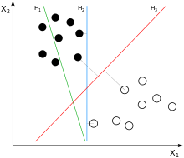
Characteristics SVM
Predictors - Numeric predictors only.
Time - Quick to fit and very quick to predict.
Time increases with the square of the size of the data.
Memory Overhead – Moderate.
Notes:
Predictors - Predictors can be all categorical or all numeric, but not a mix.
Time - Quick to fit (does not depend on the size of the data).
Prediction time increases with the square of the size of the data.
Best for small data sets (hundreds or thousands of observations).
Memory Overhead – Small.

Slide 33
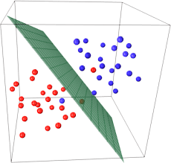
Characteristics of SVM
Common Properties to Modify
KernelFunction: Variable transformation to apply. (Default: linear.)
KernelScale: Scaling applied to all variables before the kernel transformation. (Default: 1.)
BoxConstraint: Regularization parameter controlling the misclassification penalty. (Default: 1.)
Notes:
* SVMs use a distance-based algorithm. Data is not normalized by default; use
the 'Standardize' option to change this.
* Linear SVMs work well for “wide” data (more predictors than observations).
Gaussian SVMs often work better on “tall” data (more observations than
predictors).

Slide 34
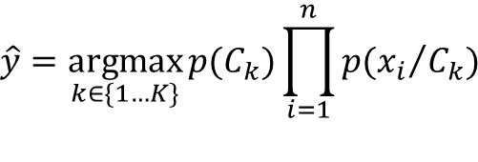
Naive Bayes
Maximum Aposteriori rule (MAP):
# features
$$\hat{y}=\underset{k∈\{1…K\}}{argmax}{p(C_{k})}\prod_{i=1}^{n}{p({x_{i}}/{C_{k}})}$$
# classes
>> nb = fitcnb (Xtrain, Y, 'Distribution', ‘normal', Name, Value)
>> activity = predict(nb ,X)
Manning, C. D., P. Raghavan, and M. Schütze. Introduction to Information Retrieval, NY: Cambridge University Press, 2008.
Notes:
naive Bayes classifiers are a family of simple probabilistic classifiers based on applying Bayes' theorem with strong (naive) independence assumptions between the features. It is not a single algorithm for training such classifiers, but a family of algorithms based on a common principle: all naive Bayes classifiers assume that the value of a particular feature is independent of the value of any other feature, given the class variable.
The Naive Bayes classifier combines a conditional probability model with a decision rule. One common rule is to pick the hypothesis that is most probable; this is known as the maximum a posteriori or MAP decision rule.
To estimate the parameters for a feature's distribution, one must assume a distribution or generate nonparametric models for the features from the training set, The assumptions on distributions of features are called the event model of the Naive Bayes classifier (Gaussian/Kernel/Multinomial/Bernoulli/, )

Slide 35
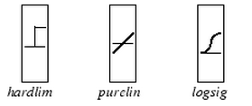






























Neural Networks
transfer function
Inputs
Neuron Layer
Layer 2
Targets
layer weights
$$\sum_{{ b}_{ 1}^{1}}{\begin{aligned}{ n}_{ 1}^{1} \\ \end{aligned}}$$
$$f^{1}$$
$$a_{ 1}^{1}$$
$${lω}_{ 1,1}^{2,1}$$
$$\sum_{{ b}_{ 1}^{2}}{\begin{aligned}{ n}_{ 1}^{2} \\ \end{aligned}}$$
$$f^{2}$$
$$a_{ 1}^{2}$$
…
$$a_{ 1}^{n}$$
input weights
$${iω}_{ 1,1}^{1,1}$$
$$\left[\begin{matrix}X_{1} \\ X_{2} \\ X_{3}\end{matrix}\right]$$
$$a_{ 2}^{n}$$
$$\sum_{{ b}_{ 2}^{1}}{\begin{aligned}{ n}_{ 2}^{1} \\ \end{aligned}}$$
$$f^{1}$$
$$a_{ 2}^{1}$$
$$\sum_{{ b}_{ 2}^{2}}{\begin{aligned}{ n}_{ 2}^{2} \\ \end{aligned}}$$
$$f^{2}$$
$$a_{ 2}^{2}$$
…
$${lω}_{ 2,2}^{2,1}$$
…
$${iω}_{ 3,3}^{1,1}$$
$$\sum_{{ b}_{ 2}^{1}}{\begin{aligned}{ n}_{ 3}^{1} \\ \end{aligned}}$$
$$a_{ 3}^{1}$$
$$\sum_{{ b}_{ 2}^{2}}{\begin{aligned}{ n}_{ 3}^{2} \\ \end{aligned}}$$
$$a_{ 3}^{2}$$
$$a_{ 3}^{n}$$
$$f^{1}$$
$$f^{2}$$
…
$${lω}_{ 3,3}^{2,1}$$
bias
bias
…
$a∈\left\{\begin{matrix}[0 & 1] \\ [−1 & 1]\end{matrix}\right.$
$\left[a^{1}\right]=$ $f^{1}(\left[iω^{1,1}\right]×\left[X\right]+ \left[b^{1}\right])$
$\left[a^{2}\right]=$ $f^{2}(\left[lω^{2,1}\right]×\left[a^{1}\right]+ \left[b^{2}\right])$
>> net = patternnet(hiddenLayerSize);
>> [net,tr] = train(net,inputs,targets,‘UseGPU', true, Name, Value);
>> activity_scores = net(X);
>> [~,activity] = max(activity_scores,[],1)

Slide 36



“Essentially, all models are wrong, but some are useful”– George Box
So… Which algorithm to use?
For an embedded Implementation
?
 | + | -
Naïve Bayes |  | Accelerations inter-correlation
SVM | Performance | Heavy implementation (multiclass)
Trees | Easy to understand | Overfitting*
KNN |  | Expensive prediction
Neural Networks | Performance | Hidden Knowledge
Automatic Codegen

Slide 37
Agenda
Machine Learning overview
Learning types and models
Machine Learning workflow
Example: Heart sound classification
Summary
Self-practice

Slide 38





















Machine Learning Workflow
Access and Explore Data
Preprocess Data
Develop Predictive Models
Integrate Analytics with Systems
Files
Working with
Messy Data
Model Creation e.g. Machine Learning
Desktop Apps
Databases
Data Reduction/
Transformation
Parameter Optimization
Enterprise Scale Systems
Sensors
Feature
Extraction
Model
Validation
Embedded Devices and Hardware
Notes:
Lets talk about the steps involved in a typical machine learning workflow.
Accessing and exploring the data is almost always the first step. This step involves reading data from different sources like various file formats, databases or even streaming data from sensors.
The first step is usually followed by the preprocessing step. In this step, raw data is manipulated and transformed for consumption by machine learning algorithms. This involves cleaning up messy data (e.g. outliers, missing values), extracting features or predictors by using domain knowledge (e.g. image features) and applying various data reduction and transformation techniques to keep only the most relevant information.
Once the data is preprocessed, it is ready for the third step, which involves development of predictive models. In this step, we have a lot of flexibility with respect to the learning technique we want to use as well as the various parameters of that technique. Typical tasks include training and comparing multiple models, optimizing model parameters and validating model performance to ensure robustness.
The final step is to share and deploy the trained models by integrating them into analytics pipelines. Models may run on embedded systems, shared as standalone applications or deployed on the cloud. The goal here is to rapidly build and deploy accurate models.
Accessing and exploring data is the first step followed by preprocessing the data to deal with issues like missing values, outliers and feature extraction. These two steps typically account for 80% of the effort.
After the preprocessing step, data is ready for training algorithms for supervised or unsupervised machine learning tasks.
In 16b, we have introduced a number of new capabilities that make it easier and faster for MATLAB users to implement this workflow. We have delivered a number of tall capable algorithms in the SML TBX that make it easy for users to perform statistical analysis and develop machine learning models with very large datasets.
Fast, robust and accurate feature selection is critical to the accuracy of the final models so we have delivered a new method that makes it easy for users to select the right features to train on.
To enhance the model development and deployment process we have added some new capabilities to the CL app and delivered a technique for selecting optimal model parameters so that the trained model can achieve high accuracy. Finally we have delivered code gen support for key machine learning algorithms, which makes it easy for users to deploy trained models to embedded targets.

Slide 39
Agenda
Machine Learning overview
Learning types and models
Machine Learning workflow
Example: Heart sound classification
Summary
Self-practice

Slide 40

Heart Sound Classification - Overview
Motivation
Heart sounds are complex signals
Require trained clinicians for diagnosis
Objective
Develop algorithm for automatic classification of heart sounds
Dataset
Training: 3240 recordings
Validation: 301 recordings
Recording Duration: 5 to 120 sec
Labels: Normal or Abnormal
PhysioNet/CiC Challenge 2016
Heart Sound Recording
Classification Algorithm
Normal
Abnormal
Notes:
This example is based on a heart sounds dataset that was used in the 2016 PhysioNet and CiC challenge.
Heart sounds contain rich information that can enable early diagnosis of serious pathologies of the cardiac system. Because listening to heart sounds requires a simple device, it is an ideal screening tool that can be used in the field to identify and refer at risk individuals for further testing. However, the heart sound signal is highly complex and reliable diagnosis requires a trained clinician.
In this example, our objective is to develop an algorithm that can be used for automatic classification of heart sounds with the goal of deploying the final solution on an embedded system for real-time diagnosis.
The dataset consists of a training and validation set. The training set consists of 3240 recordings and validation set consists of 301 recordings. The recordings are of variable length, ranging from 5 seconds to 120 seconds. Each recording comes with a label of either ‘Normal’ or ‘Abnormal’.

Slide 41

Heart Sound Classification
Notes:
In this webinar, we will focus on one such application where applying machine learning to develop a solution is a good fit. Using a real-world dataset, we will use the machine learning workflow to go from raw sensor data to real-time classification of heart sounds as shown in this video. Along the way, we will identify several essential tools that enable us to quickly develop and deploy robust machine learning solutions.

Slide 42
Heart Sound Classification - ML Workflow
Access and Explore Data
Preprocess Data
Develop Predictive Models
Integrate Analytics with Systems
Statistics & Machine Learning Toolbox
Files
Working with
Messy Data
Model Creation e.g. Machine Learning
Desktop Apps
Wavelet Toolbox
Databases
Data Reduction/
Transformation
Parameter Optimization
Enterprise Scale Systems
Signal Processing Toolbox
Statistics & Machine Learning Toolbox
MATLAB Coder
Sensors
Feature
Extraction
Model
Validation
Embedded Devices and Hardware
MATLAB
Notes:
In the heart sounds example, we will focus on a subset of elements from the workflow that we reviewed earlier.
Our dataset consists of files with recordings of sensor data.
In the preprocessing step we will focus on feature extraction and feature selection to identify the most relevant features.
To develop our predictive model, we will train and compare multiple models, perform parameter optimization and validate our model on new data.
Finally, we will take our machine learning solution and prepare it for deployment to an embedded system.
Throughout this example, we will use MATLAB as our programming language.
In the preprocessing step, we will rely on the capabilities provided by the Signal Processing Toolbox and Wavelet Toolbox for feature extraction and Statistics & Machine Learning Toolbox for feature selection.
We will use apps and algorithms from the Statistics & Machine Learning Toolbox for developing predictive models and use MATLAB Coder to generate C code from MATLAB code for deployment.
Accessing and exploring data is the first step followed by preprocessing the data to deal with issues like missing values, outliers and feature extraction. These two steps typically account for 80% of the effort.
After the preprocessing step, data is ready for training algorithms for supervised or unsupervised machine learning tasks.
In 16b, we have introduced a number of new capabilities that make it easier and faster for MATLAB users to implement this workflow. We have delivered a number of tall capable algorithms in the SML TBX that make it easy for users to perform statistical analysis and develop machine learning models with very large datasets.
Fast, robust and accurate feature selection is critical to the accuracy of the final models so we have delivered a new method that makes it easy for users to select the right features to train on.
To enhance the model development and deployment process we have added some new capabilities to the CL app and delivered a technique for selecting optimal model parameters so that the trained model can achieve high accuracy. Finally we have delivered code gen support for key machine learning algorithms, which makes it easy for users to deploy trained models to embedded targets.

Slide 43




Heart Sound Classification - Key Takeaways
Use apps in your workflow to quickly compare and select candidate algorithms
Use feature selection to get rid of unnecessary features and prevent overfitting
Use programmatic workflows for fine-tuning model parameters to achieve robust performance
Use automatic code generation to rapidly deploy your analytics to embedded targets
Notes:
To summarize, here are some key takeaways about how tools available in MATLAB enable you to rapidly develop and deploy machine learning models.

Slide 44
Agenda
Machine Learning overview
Learning types and models
Machine Learning workflow
Example: Heart sound classification
Summary
Self-practice

Slide 45
Challenges in Machine Learning
Steps | Challenge
Access and Explore data | Data diversity Numeric, Images, Signals, Text – not always tabular
Preprocess Data | Lack of domain tools Filtering and feature extraction Feature selection and transformation
Develop Predictive Models | Time consuming Train and compare several models to find the “best” Select optimal parameters and avoid overfitting
Integrate Analytics with Systems | Platform diversity Translate analytics to production Deploy on different target platforms
Iterate
Notes:
Let’s review some of the challenges that we encountered during the workflow of our example.
Data access and exploration often involves working with data the comes in all shapes and sizes. Real world datasets are messy and not always tabular
Preprocessing data requires domain specific algorithms and tools,
For example, signal or image processing algorithms are required to extract useful features from signal and image data. When dealing with high dimensional datasets, selecting the right set of features is often important to avoid overfitting issues.
Developing and selecting predictive models that generalize well requires training and comparing multiple algorithms. Algorithms often require careful parameter tuning which can be a time consuming process.
Integration and deploying analytics often requires translating or interfacing with different hardware and software platforms. This can be a bottleneck for applications that require frequent model updates.
Finally, machine learning workflows are never in a convenient linear fashion, we have constantly go back and forth and iterate and try different ideas.

Slide 46
MATLAB Strengths for Machine Learning
Challenge | Solution
Data diversity | Extensive data support Work with signal, images, financial, textual, and others formats
Lack of domain tools | High-quality libraries Industry-standard algorithms for Finance, Statistics, Signal, Image processing & more
Time consuming | Interactive, app-driven workflows Focus on machine learning, not programing Select best model and easily fine-tune model parameter
Platform diversity | Run analytics anywhere Code generation for embedded targets Deploy to broad range of enterprise system architectures
 | Flexible architecture for customized workflows Complete machine learning platform
Notes:
For the first challenge of data diversity, we saw how MATLAB can work with different types of data, MATLAB can also work directly with financial datafeeds, text, geospatial data and several other formats.
MATLAB has high quality libraries of industry-standard algorithms and function that enable feature engineering without requiring domain expertise. MATLAB also provides tools for evaluating and selecting the right set of features for both tall and wide datasets.
With interactive app driven workflows, we can quickly train and compare models so the focus can be on machine learning not programming and debugging. Tight integration of parameter tuning techniques enables development of models with optimal parameters.
MATLAB enables deployment of analytics on a broad range of platforms ranging from standalone apps to enterprise scale systems. Code generation makes it easy to produce standalone code that can be rapidly deployed to embedded systems.
Finally, MATLAB is an inherently flexible modeling environment and a complete programming language with no restrictions to the customization you can make to your analysis. This makes MATLAB an excellent platform for machine learning.

Slide 47



Additional Resources
ML with MATLAB website mathworks.com/machine-learning
MATLAB documentation
Systematics ML Course www.systematics.co.il/courses/mathworks/
Notes:
למידע נוסף אתם מוזמנים להכנס לאתר מתוורקס, או לדוקיומנטציה
ולהגיע אל קורסים מקצועיים אצלנו בסיסטמטיקס

Slide 48
Agenda
Machine Learning overview
Learning types and models
Machine Learning workflow
Example: Heart sound classification
Summary
Self-practice

Slide 49


Classify Samples - Benign or Malignant?
569 Cell Samples
30 features: Radius, Symmetry, Diameter,
Area, Smoothness, Circumference, Compactness, etc.
Classified by expert: Malignant (M) or Benign (B)
SOURCE: http://pages.cs.wisc.edu/~olvi/uwmp/cancer.html

Slide 50
Classify Samples - Benign or Malignant?
Fast import of data to MATLAB
Use the Classification Learner App
Easily compare different types of classifiers
Use graphic tools to examine classifiers results
Export a trained model and use the model for prediction
Generate MATLAB code for classifier training

Slide 51


Slide 52
Different Types of Learning
Type of Learning
Categories of Algorithms
Classification
Output is a choice between classes (True, False) (Red, Blue, Green)
Supervised Learning
Regression
Output is a real number (temperature, stock prices)
Develop predictive model based on both input and output data
Machine Learning
Unsupervised Learning
Clustering
No output - find natural groups and patterns from input data only
Discover an internal representation from input data only
Notes:
Machine learning can be broadly divided into supervised and unsupervised learning.
In supervised learning, the dataset includes input values as well as corresponding output and our task is to train a model to predict or estimate the output on new data. If the output has discreet values, we refer to it as a classification problem whereas if the output is continuous, we refer to it as a regression problem.
For example, if you are trying to predict tumor size into small, medium, large, then it is a classification problem. While if you are trying to predict electricity demand from a grid (in kW-hrs), then it is a regression problem.
In case of unsupervised learning, our task is to group the data based on some measure of similarity. The input dataset does not have corresponding output or labels so many different solutions are possible and our goal is to discover the naturally occuring patterns in the data. Clustering techniques fall under the category of unsupervised learning.
An example of unsupervised learning is the problem of determining the optimal placement of antennas so that all cellular customers recieve good service.

Slide 53
Different Types of Learning
Type of Learning
Categories of Algorithms
Classification
Support Vector Machines
Discriminant Analysis
Naive Bayes
Nearest Neighbor
Supervised Learning
Regression
Linear RegressionGLM
SVR,
GPR
Ensemble Methods
Regression Trees
Neural
Networks
Develop predictive model based on both input and output data
Machine Learning
Unsupervised Learning
Clustering
kMeans, kmedoids
Fuzzy C-Means
Hierarchical
Gaussian Mixture
Neural Networks
Hidden Markov Model
Discover an internal representation from input data only
Notes:
Here are some examples of techniques under each category.
SVM and DA are examples of classification techniques, linear regression and regression trees are examples of Regression techniques and k-means and gaussian mixture models are examples of clustering techniques.

Slide 54


Characteristics and Examples
Characteristics
System too complex to know the governing equation (e.g., black-box modeling)
Lots of data (many variables)
Examples
Financial algorithms (credit scoring, algo trading)
Pattern recognition (speech, images)
Biology (tumor detection, drug discovery)
Energy forecasting (load, price)

